Slide 1



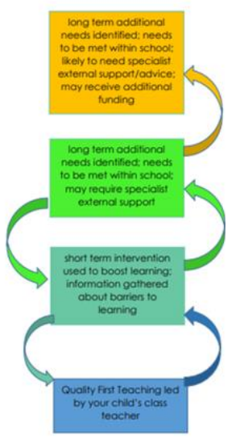
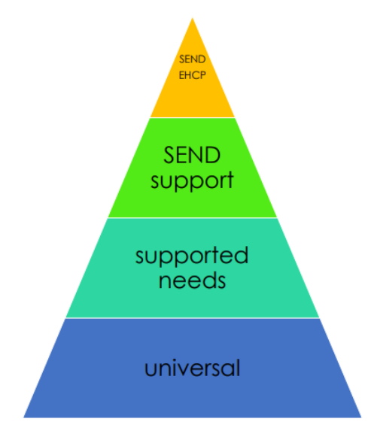
Sacred Heart Catholic Primary SEND Information Report 2024-2025
What can I do if I think my child has unidentified additional needs?
Speak to your child’s class teacher in the first instance. They will discuss what support is/can be provided within school. If your child’s needs continue to be a barrier to learning and require further investigation staff will involve the SENCo. Individual assessments or referrals to external agencies can be arranged as appropriate. A pupil is identified as requiring SEND support if their attainment is significantly below that of their peers or their potential and there is a diagnosis or working diagnosis relating to their additional needs.
My child has recognised additional needs before joining the school. How will you meet their needs?
If your child is already identified as requiring SEND support or has an EHCP it is important that you talk to us about this. We will contact your child’s current school/pre-school to ensure that we understand how they have been supported. We will talk to you about how we plan to ensure there is a smooth transition into Sacred Heart.
My child has recognised additional needs and is moving on. What contact do you have with their new school?
In Year 6 we start the transition process early in the summer term. We contact the SENCo at your child’s new school and arrange a meeting to discuss their needs. Each secondary school has their own transition process but most pupils will attend extra settling-in sessions in the summer term. If your child is moving on before Year 6 we will contact the SENCo at your child’s new school to arrange the transition.

Slide 2
Categories of need:
Your child may be recognised as having additional needs in one or more area:
• Communication & interaction
• Cognition & learning
• Social, mental & emotional health
• Sensory &/or physical
We will support your child whatever their needs
Supported needs
• Teacher identifies areas of weakness and plans support and/or intervention, taking advice from subject leaders, EAL lead or SENCo as appropriate
• Progress monitored and teacher continues to refine support
• Teacher consults SENCo assisting as appropriate with assessment, selecting well-founded intervention and seeking advice/assessment from external agencies
• Parents consulted throughout, and joint decision made if pupil’s needs should be identified as requiring SEND support
External agencies used:
• Educational Psychology Service
• Speech and Language Therapy Service
• Autism Outreach Service
• School Nursing Team
• Occupational Therapy
In school support & expertise:
• Learning Mentor supports pupils with additional emotional and/or social needs
• Staff trained in reading, spelling & language/communication interventions
• Trauma aware staff
• Specific SEND training accessed by staff as appropriate
EHCP
• Pupil profile created detailing strengths & weaknesses SENCO and staff consult about provision: adjustments made/ targeted support provided
• Termly meetings with pupil/parents/staff/SENCo to discuss progress
• Annual review with parents/staff/SENCo/specialists
What happens at each stage & how can parents & pupils participate in the process?
Universal
• Class teacher responsible for ensuring teaching adjusted to meet the needs of each pupil in class (QFT)
• Pupil may be identified in termly pupil progress meetings or parent may raise concern which suggests further support is required
SEND Support
• Pupil profile created detailing strengths & weaknesses
• SENCO and staff consult about provision: adjustments made/ targeted support provided
• Termly meetings with pupil/parents/staff/SENCo (PCD) to discuss progress
• SENCo or parent may suggest EHCP process to be considered
Inclusion:
All pupils are encouraged to take part in all activities & trips arranged for their class.
Activities can be adapted or resources used to enable all pupils to be included. Parents are encouraged to discuss their child’s specific needs with the class teacher.
Complaints:
Please speak to your child’s class teacher in the first instance and then the SENCo. If not happy with the response, contact the Headteacher in writing. Full details can be found complaints policy available on the school website
Contact
SENCo: Corinne Dalton
Contact: 01733 262449
Headteacher: Thomas Claxton
Email: office@sacredheart.peterborough.sch.uk
SEND Governor: Helen Goodliffe
SEND Local Offer - for more information of what is on offer in Peterborough:
https://fis.peterborough.gov.uk/kb5/peterborough/directory/localoffer.page?familychannel=8

